Slide 1

Shree Ramswaroop Memorial University
JavaScript Lab Assignment 5
Submitted to : Kshitiz Srivastav
Submitted By : Mukesh Prajapati
Branch : B . tech (cs industry integrated)
Roll-No : 202410101230007

Slide 2
Weather App

Slide 3
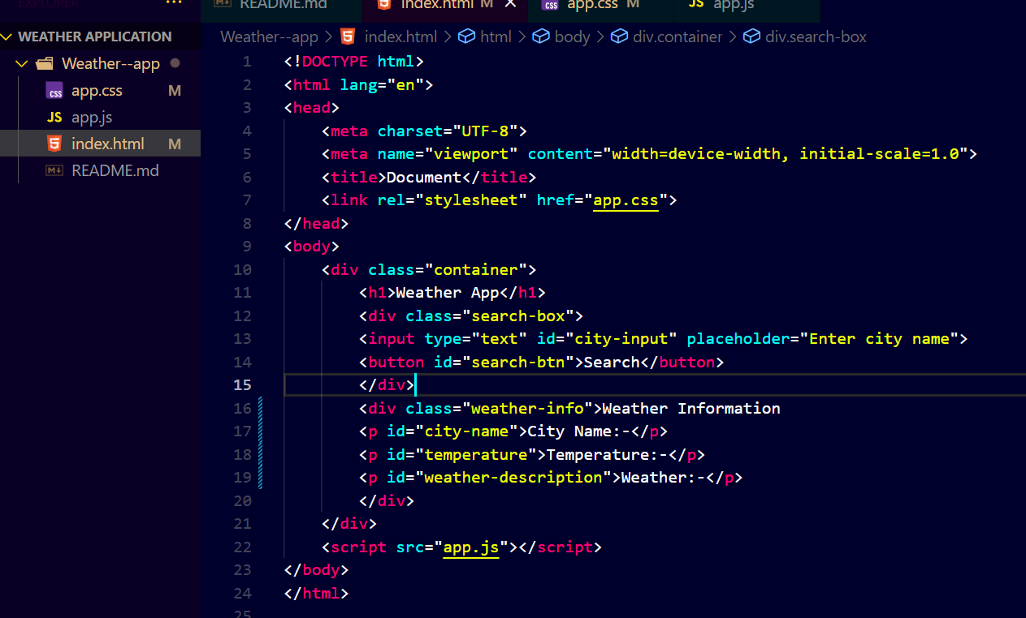
EXPERIMENT:--5
JavaScript Function to Fetch Weather Data
HTML Code:-
Small changing in HTML code added weather information, city name, temperature, weather.

Slide 4
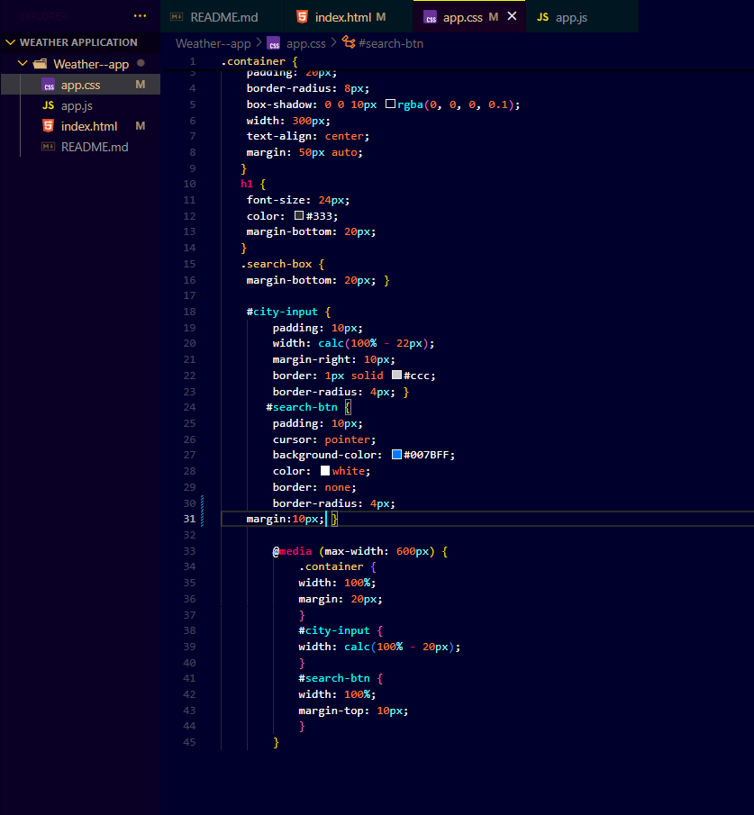
No change in css codes:-
CSS Code:-

Slide 5
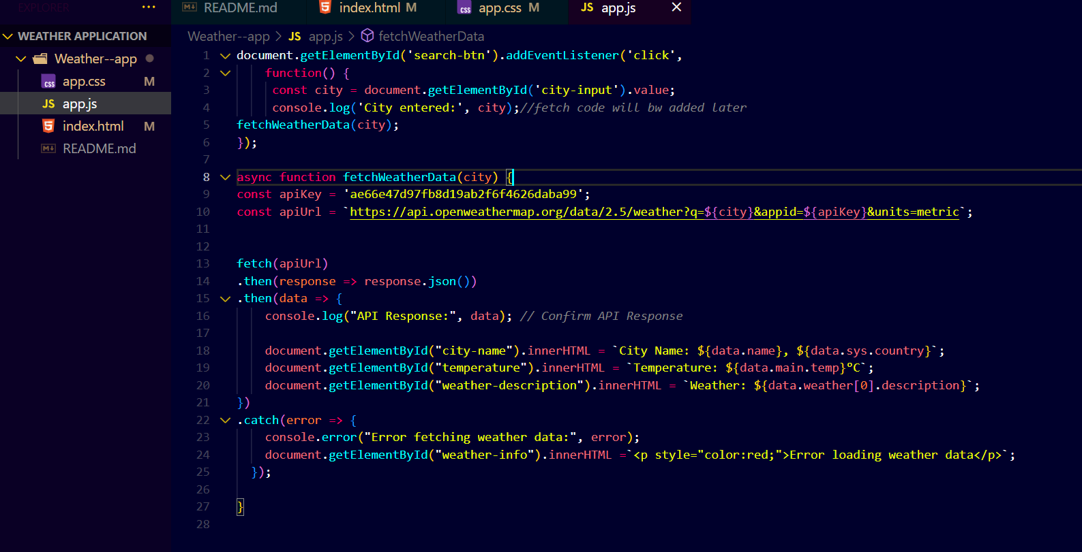
JavaScript Code:-
Here is the modified code of javaScript that fetching function of weather data

Slide 6
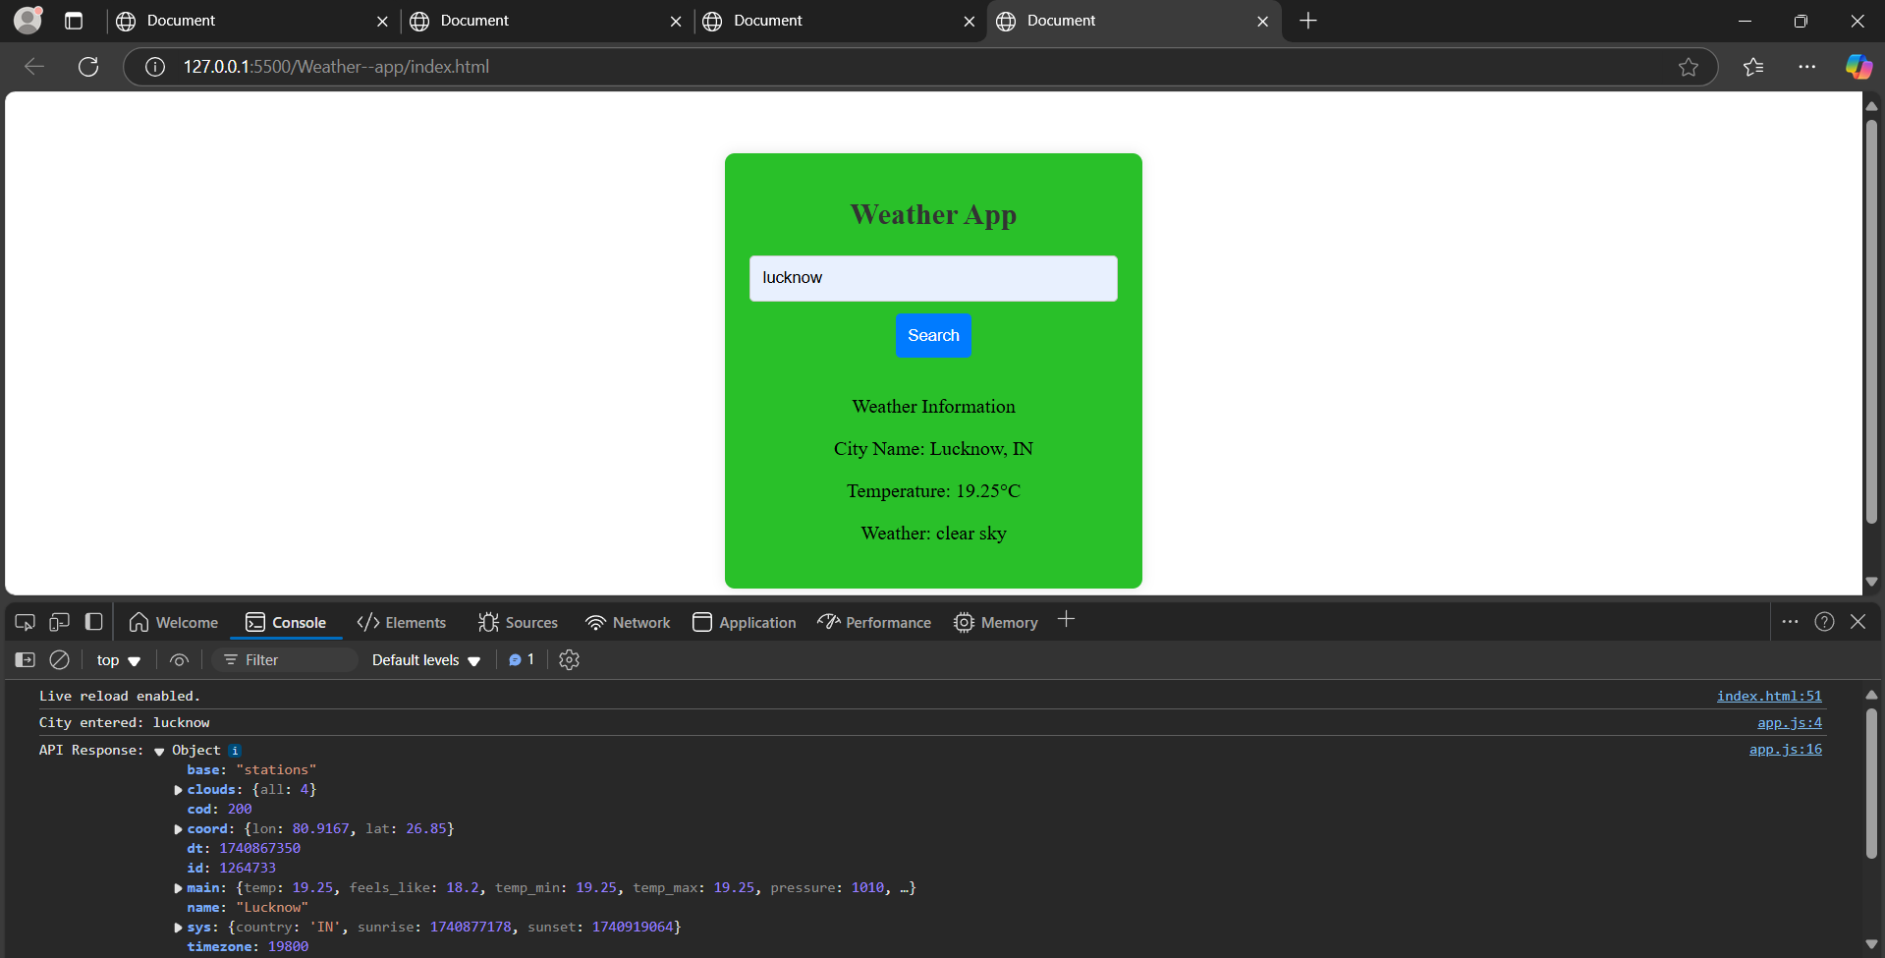
Result of output:-

Slide 7
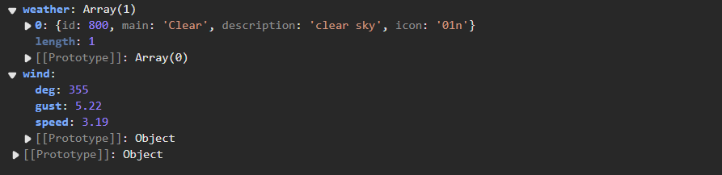
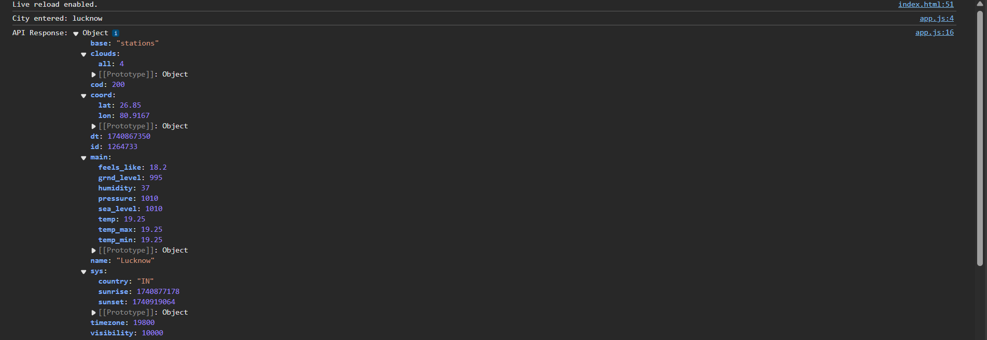
More information of console:-

Slide 8
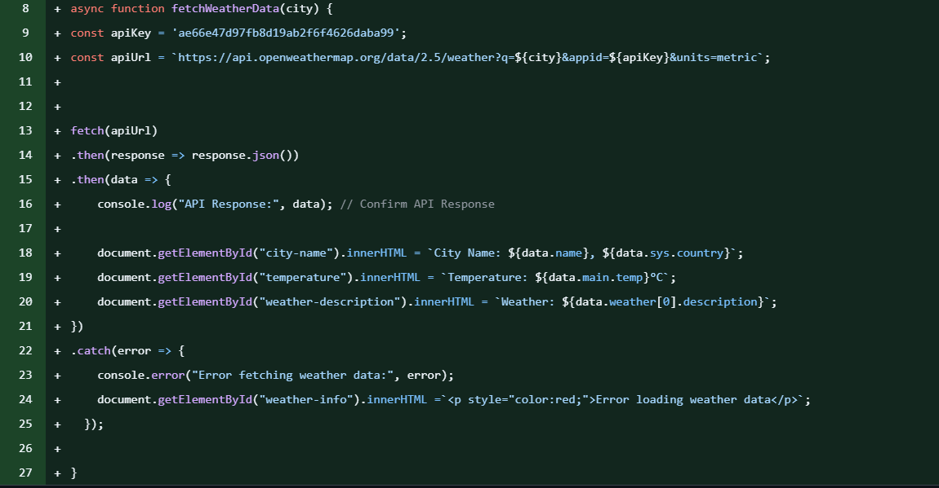
Commit Changes in 5th Experiment:

Slide 9
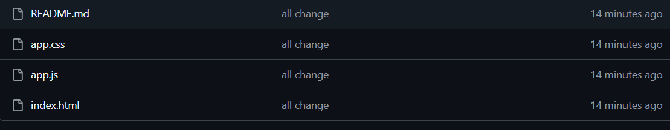
Here is the Commit changes till 5th Experiment:-

